Slide 1

Final Project
Advances in Data Sciences Product Review Sentiment Analysis
Group - 3
Archana Chintha
Bhanuja Nagore
Nithin Kartha
XingShu Cui
Mar 15th, 2017
Professor: Dr. Subrata Das

Slide 2

Table of Contents:
Problem Statement
Approach & Method Used
Data Scraping & Storing
Stemming & Sentiment Analysis
DBN
SVM
CNN
Data Story

Slide 3

Problem Statement & Approach
Data Scraping and Storing –(Using Rvest and CSS selectors)
Stemming lexicon and reviews.
Sentiment Analysis using positive/negative lexicon.
Model Building – (DBN, CNN and SVM)
Sentiment Analysis is the process of computing, identifying or categorizing opinions expressed in a piece of text, in order to determine weather the attitude expressed in it is positive, negative, or neutral.

Slide 4
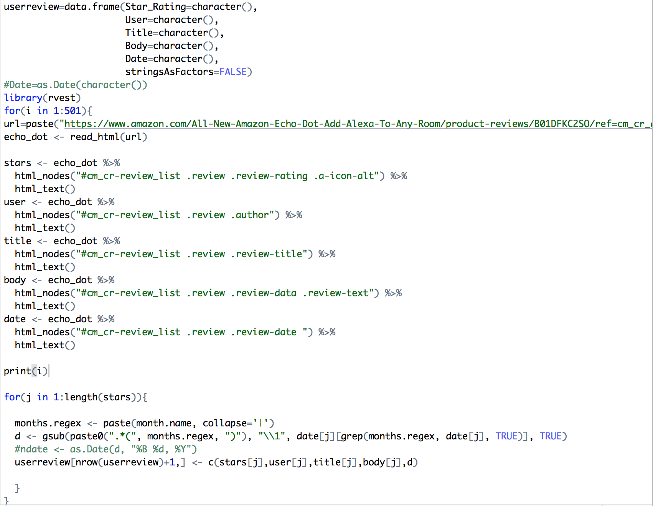
Data Scraping
Web scraping is data scraping used for extracting data from websites. With web scraping we can access the World Wide Web directly using the HTTP or through a browser.
Steps involved during Web scraping were:
Looped Amazon Echo dot product review page URL for 500 pages.
Using Rvest and CSS selectors scrubbed 5000 review along with UserrId and Star Ratings.
Notes:
Lesson descriptions should be brief.

Slide 5
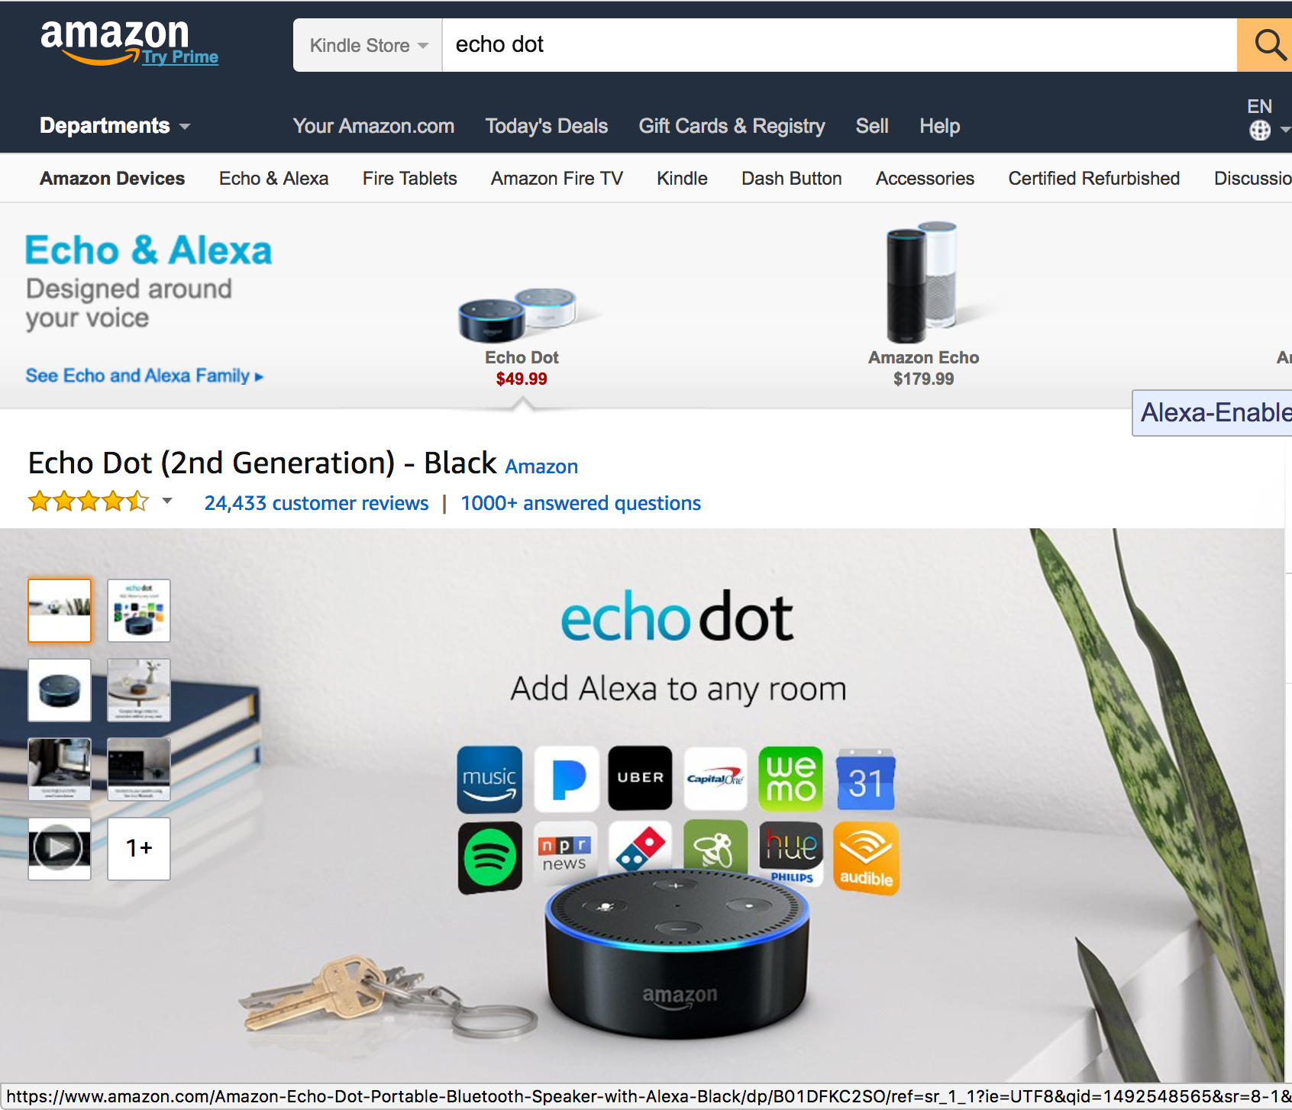
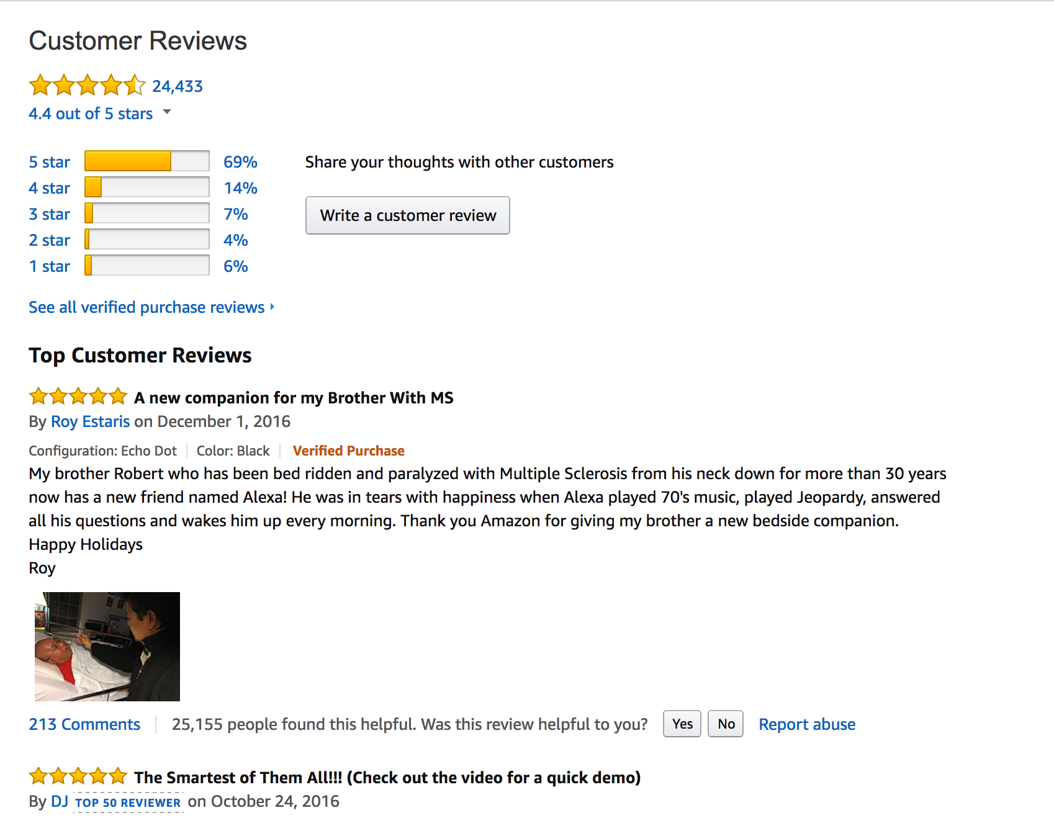

Slide 6
–

Slide 7
–

Slide 8
–

Slide 9
–

Slide 10
–

Slide 11
–

Slide 12
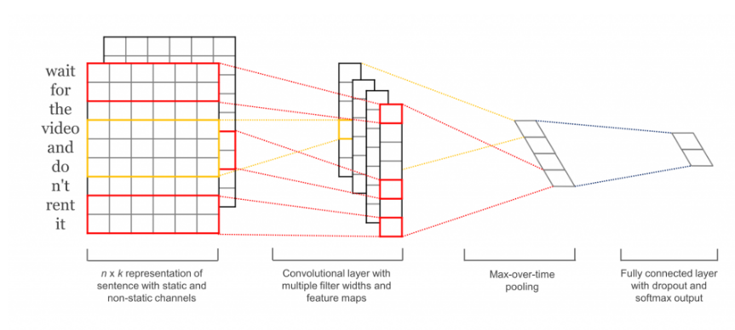
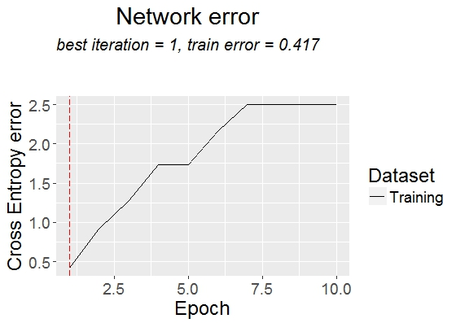
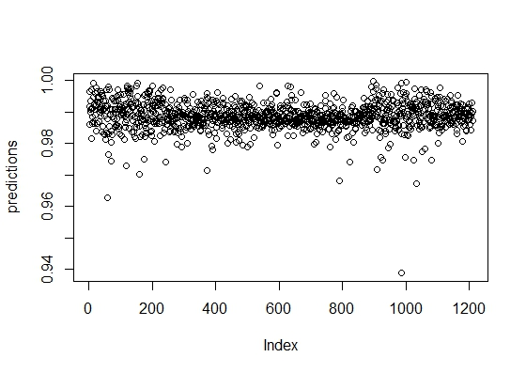
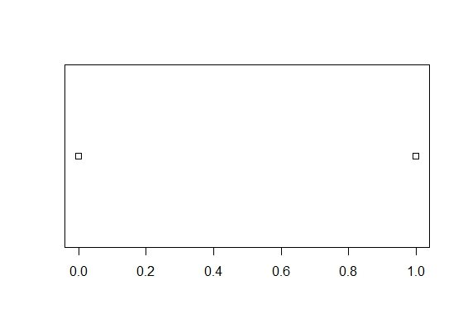
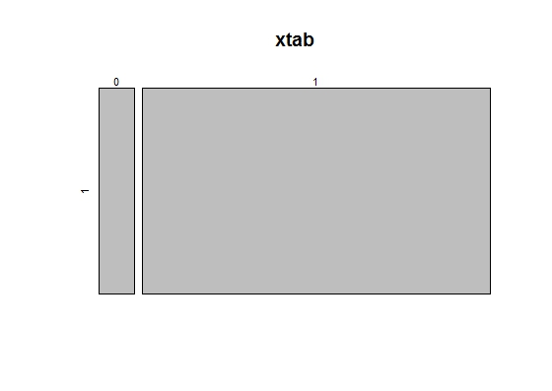
CNN FOR TEXT CLASSIFICATION
Model achieves a good classification performance across a range of text classification tasks (like Sentiment Analysis) and has since become a standard baseline for new text classification architectures
The first layers embeds words into low-dimensional vectors
The next layer performs convolutions over the embedded word vectors using multiple filter sizes
Data and processing
Train a convolutional deep network model on product review sentences from Amazon labeled with their sentiment.
The result is a model that can classify a sentence based on its sentiment (with 1 being a positive sentiment, 0 being a negative sentiment)
Fetched the labeled training data of positive and negative sentiment sentences
Processed it into sets of vectors that are then split into train and test sets 75% train & 25% test
Executed the training and testing, which in-part mxnet automatically does

Slide 13
CNN: Introduction & Steps
Model achieves a good classification performance across a range of text classification tasks (like Sentiment Analysis) and has since become a standard baseline for new text classification architectures
The first layers embeds words into low-dimensional vectors
The next layer performs convolutions over the embedded word vectors using multiple filter sizes
Steps involved during building the CNN:
Train a convolutional deep network model on product review sentences from Amazon labeled with their sentiment
Sampling the train dataset by splitting it into 75% train data and 25% test data
Building the CNN model using the train data and checking the predicted data accuracy using confusion matrix
Evaluate the model accuracy using the Confusion Matrix function of caret package
The result is a model that can classify a sentence based on its sentiment (with 1 being a positive sentiment, 0 being a negative sentiment)
Fetched the labeled training data of positive and negative sentiment sentences
Processed it into sets of vectors that are then split into train and test
Executed the training and testing, which in-part mxnet automatically does
Notes:
Lesson descriptions should be brief.

Slide 14
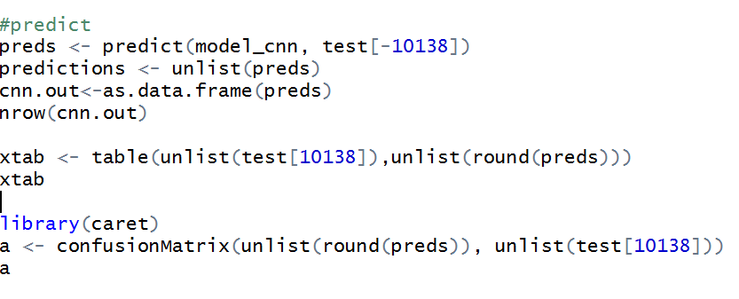
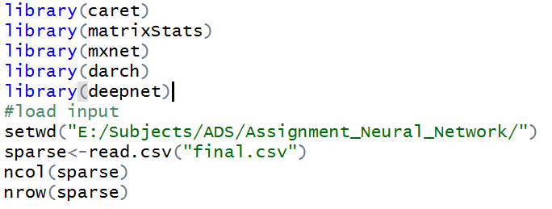
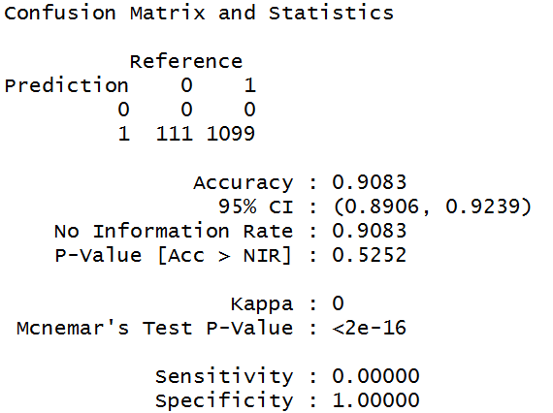
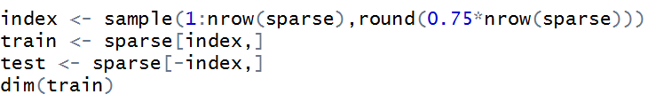
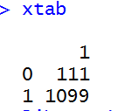
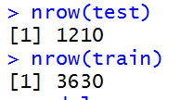
CNN – Code

Slide 15
Data Story
Previously the data had many missing and noise. By preprocessing the data all the noise and outliers are removed.
After applying the three models on preprocessed data, we predicted the level of risk and eligibility for applicants.
Three different results has been obtained, based on which the error, performance and accuracy level is computed
Comparing the three accuracy levels the root mean square error(RMSE) of linear regression is the lowest(0.0216). In SVM the accuracy level obtained from RMSE is 0.058. And in decision tree the RMSE value is 2.02. Hence linear regression is best model to predict Prudential life insurance dataset.

Slide 16
Thank You!

